Slide 1
GROUP MEMBERS
NAME | ID
MOHAMMAD MOSHFIQUE UDDIN | 1812082042
ROHIT ROY | 1811270042
MD. RAUFUL ISLAM RONY | 1522041642
PROJECT
CSE 323
GROUP 9

Slide 2
TEXT
RECOGNITION
& SPEECH
FROM PICTURE
TOPIC

Slide 3
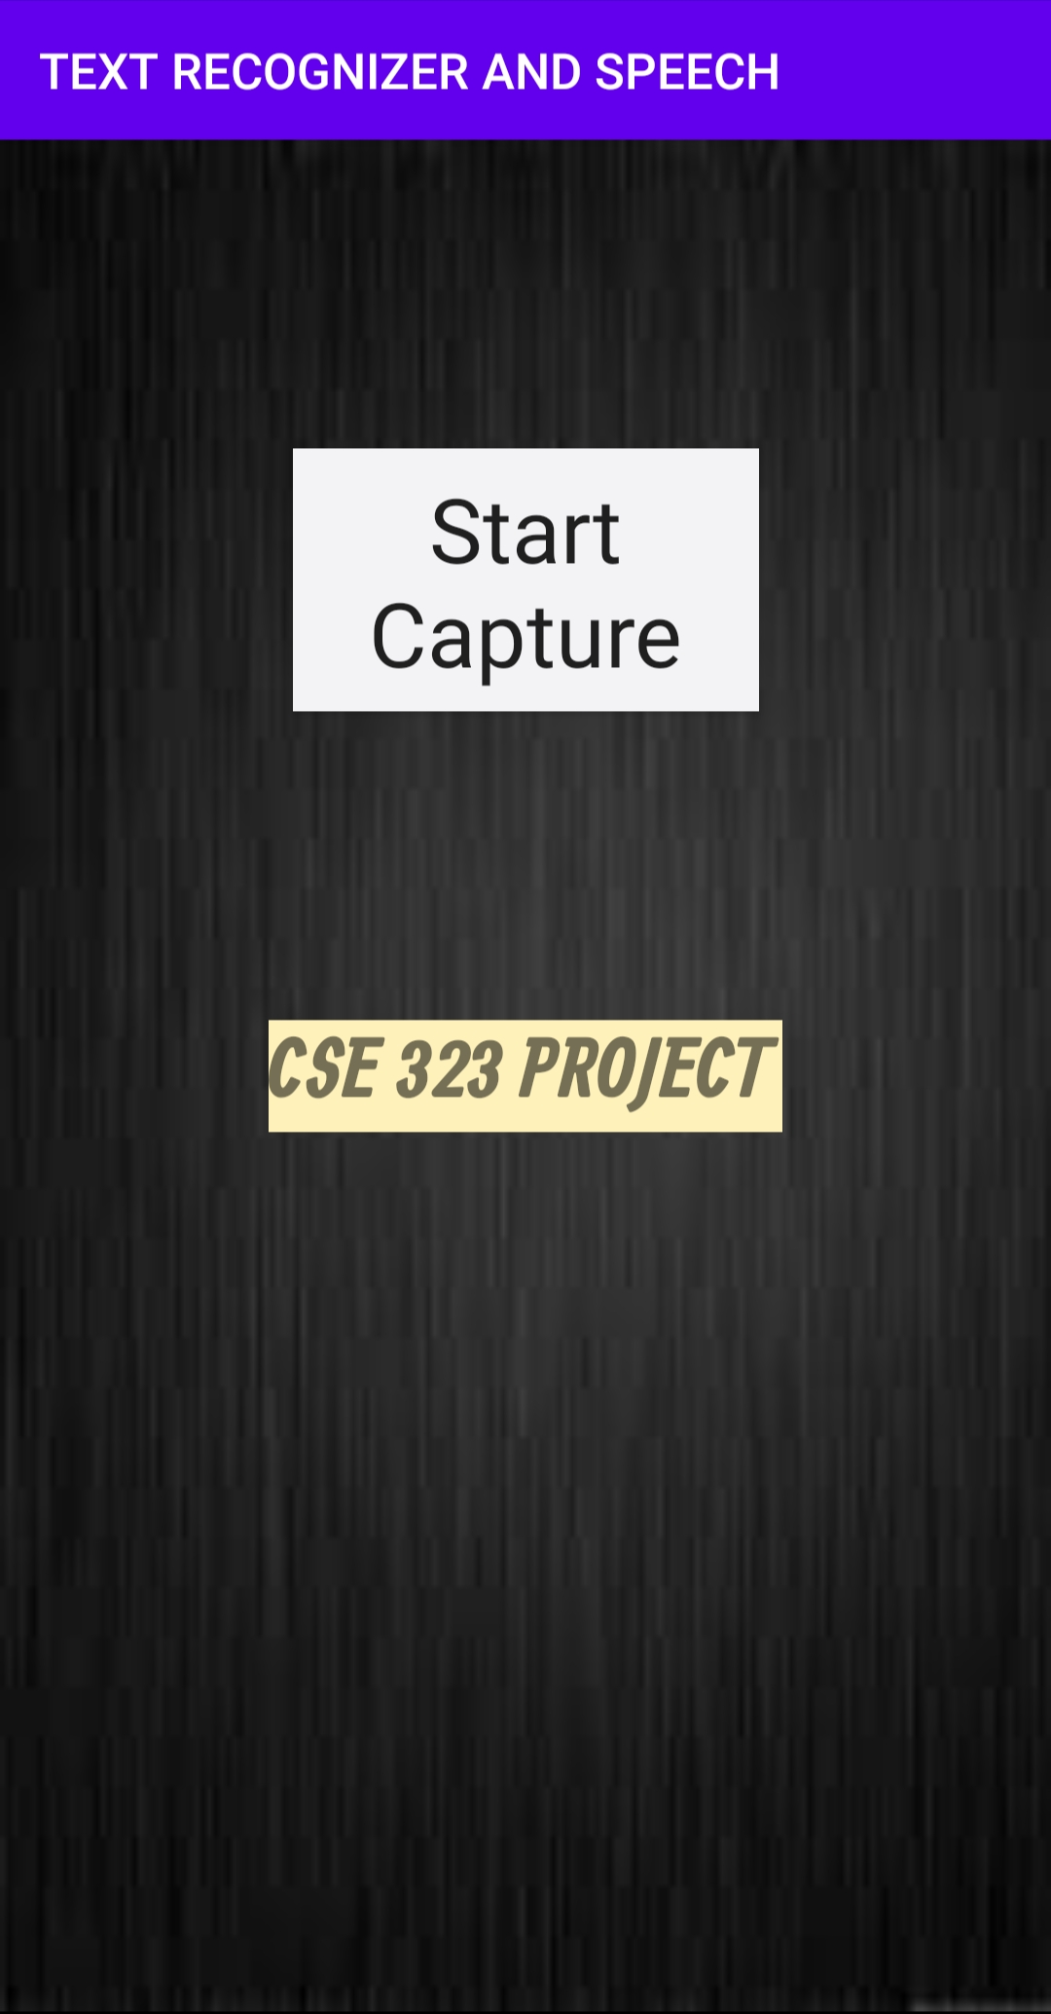
INTRODUCTION
GOALS
MODEL
WORKING METHOD
PROS AND CONS
FUTURE API
REQUIREMENTS
APP SCREENSHOT
In this project we have created an android application named “Text Recognition And Speech From Picture”.
Text recognition is the process of detecting text in images and recognizing the text contained therein.
Once detected, the recognizer then determines the actual text in each block and segments it into lines and words. The Text API detects text in real time, on device.
After detecting the text the recognizer then convert the text into speech.
It is also called Optical Character Recognitions(OCR).

Slide 4
FUTURE API
GOALS
MODEL
WORKING METHOD
REQUIREMENTS
INTRODUCTION
PROS AND CONS
This app will detect text from Images.
After detecting the text it will display the text.
Then it converts the text into speech.
Our main goal is to detect text from any kind of images.

Slide 5
INTRODUCTION
GOALS
MODEL
WORKING METHOD
PROS AND CONS
FUTURE API
REQUIREMENTS
TEXT RECOGNITION AND SPEECH FROM PICTURE
START CAPTURING
TEXT RECOGNIZER API
TEXT DETECTED
TEXT TO SPEECH API
PRONUNCIATION OF TEXT

Slide 6
FUTURE API
INTRODUCTION
GOALS
MODEL
WORKING METHOD
REQUIREMENTS
PROS AND CONS
We use Text Recognizer API from the google vision.
To use this API the required libraries are implemented in the Gradle (App) file.
Once implemented in the Gradle file, it makes the required APIs available in the Java code.
In layout, it creates a separate constraint layout for surface view.
This surface view is used to project the camera focus area.
In the end, in this App, it also converts the read text into Speech using the Text To Speech API.
When we open the app and press the “start capture” button then the camera starts and start
detecting the text from the captured image.
After detecting it shows the text and at last using the Text To Speech API, it converts the
text into speech.

Slide 7
INTRODUCTION
GOALS
MODEL
WORKING METHOD
PROS AND CONS
FUTURE API
 |  |  |  | REQUIREMENTS
ANDROID VERSION | 4.1 JELLYBEAN
MINIMUM SDK VERSION | 16
PLAY SERVICES VERSION | 19.0.0
BUILD IN | ANDROID STUDIO
OPERATING SYSTEM | ANDROID
HEADPHONE SUPPORTED | YES

Slide 8
FUTURE API
GOALS
MODEL
WORKING METHOD
REQUIREMENTS
INTRODUCTION
PROS AND CONS
ADVANTAGES | DISADVANTAGES
This app is useful for those who have optical issues. By using this app they can hear what text is written. Anyone can easily capture text from images. This app is flexible and easy to use. We can hear the sound by using headphones also. | This is a amateur level app so it has many limitations. It is hard to detect a line containing more than 3/4 words for this app. It only can detect English words. It needs clear picture for detecting text. This app can only detect real time images text.

Slide 9

GOALS
MODEL
WORKING METHOD
FUTURE API
INTRODUCTION
REQUIREMENTS
PROS AND CONS
Right now we have many limitations using this app cause it is in beginner level.
We have plans to develop this app for future purpose and upgrade its features.
We will improve the capability of detecting text.
In future we may upload it in google play store.

Slide 10
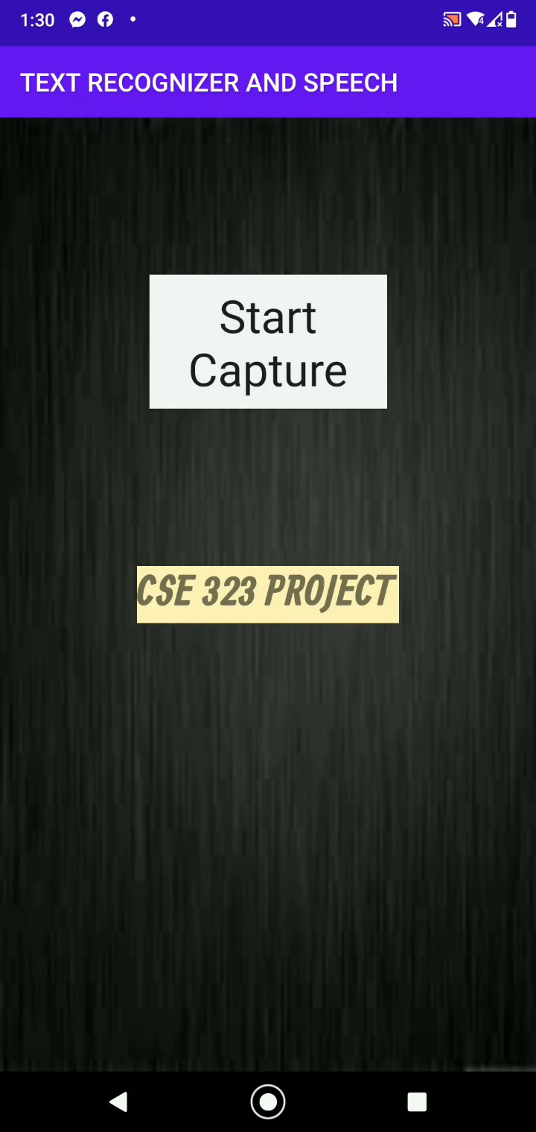

Slide 11
THANK
YOU

